Slide 1

IMPLEMENTATION OF IMPEDANCE CONTROL FOR A TELE-ECHOGRAPHIC SYSTEM
Caterina Borzillo - 1808187 Federica Cocci - 1802435 Damiano Gasperini - 1796880
Matteo Germano - 1807599
Medical Robotics - 01/04/2022

Slide 2



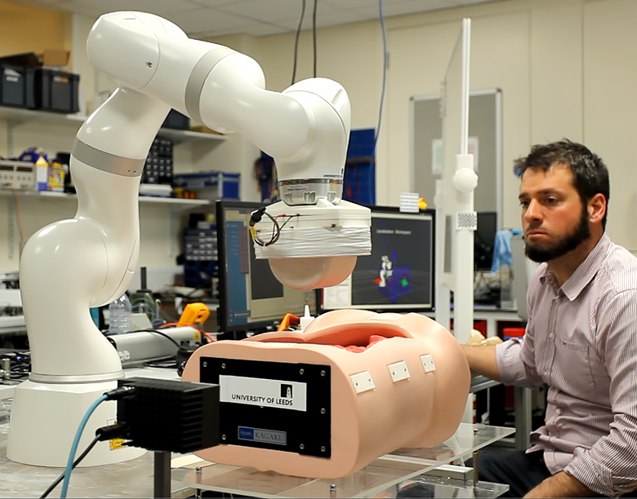
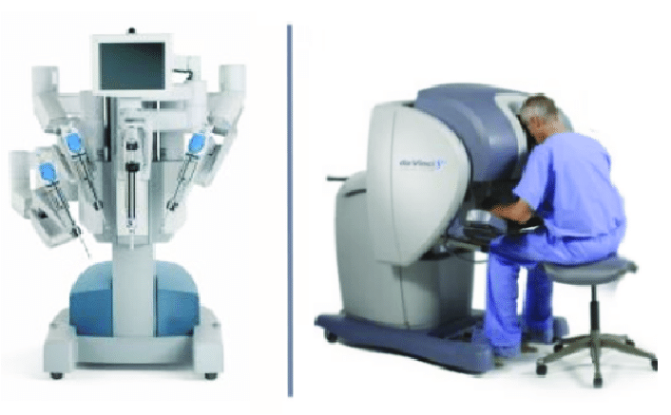
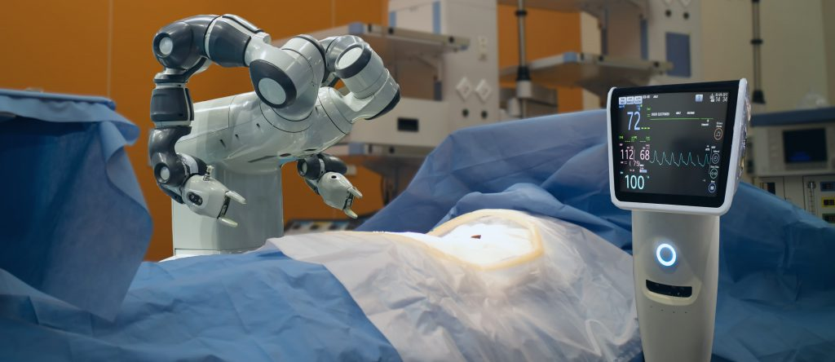
Introduction
Thanks to the rapid development of the Internet and of new technologies, such as robotics,
tele-medicine and in particular teleoperated systems had the opportunity to spread worldwide.

Slide 3
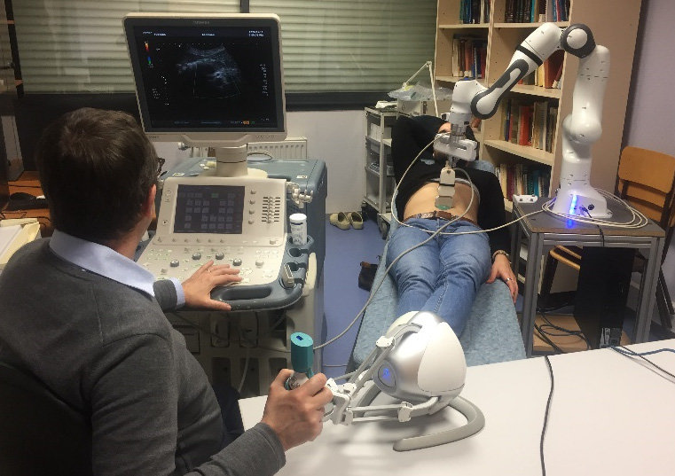
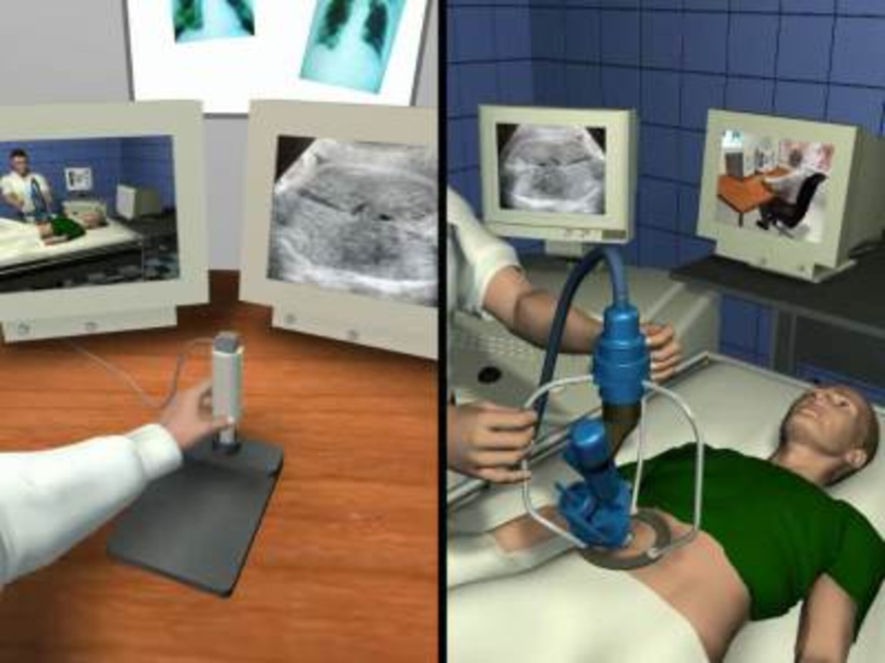
What is a tele-echographic system?
- It is a teleoperated system that is able to perform a remote examination which consists in the analysis and then transmission of ultrasound video images conducted by an expert doctor on a patient supported by a technician. Those systems are classified in:
short-distance:
long-distance:
The master and slave systems located in the same room.
The master and slave sites are geographically separated.

Slide 4
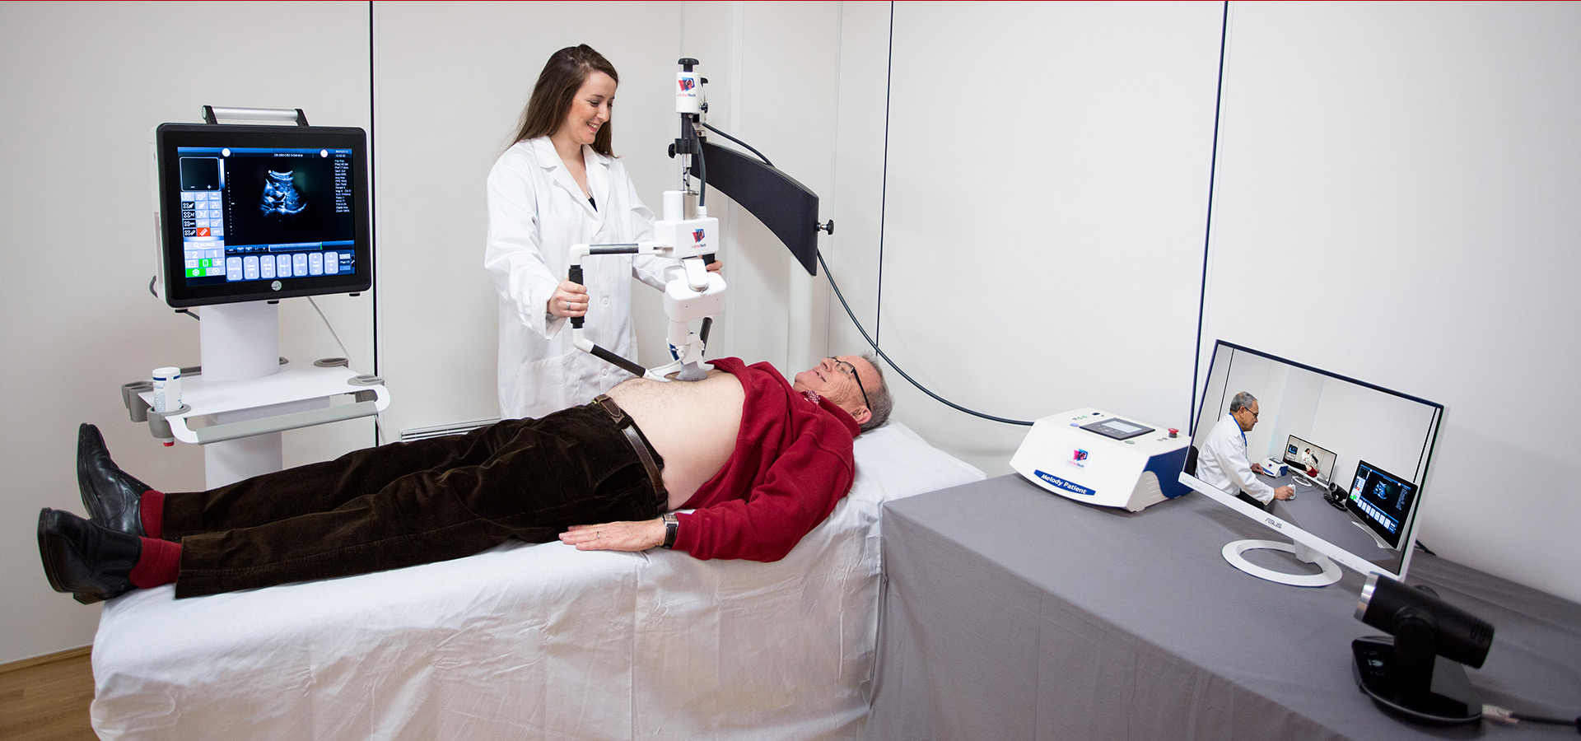
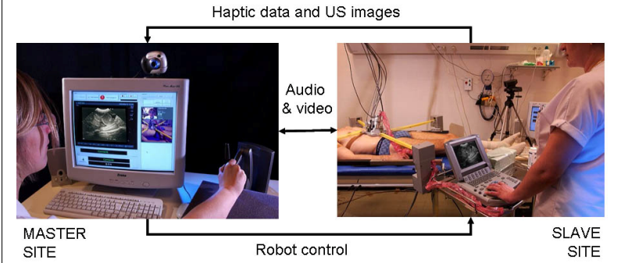
State of the art (1)
the MELODY system
the TER system

Slide 5
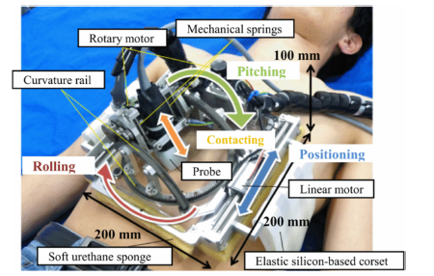
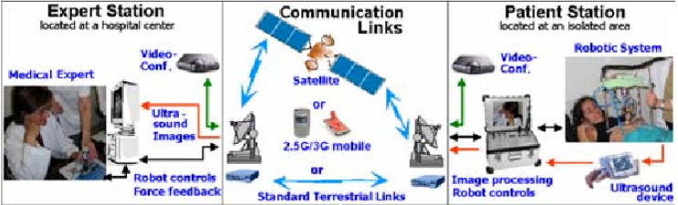
State of the art (2)
The FASTele system
The OTELO system

Slide 6

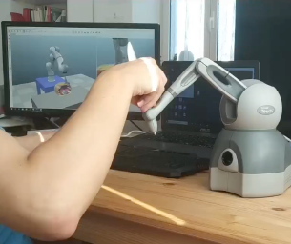

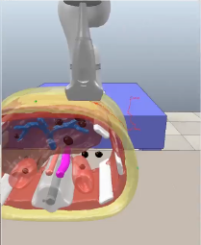

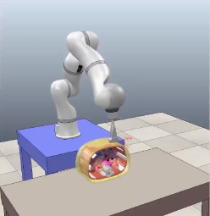

Task of the project
The simulated manipulator is equipped with an ultrasound probe which will be in contact with an abdomen phantom.
Our task: implementation of an impedance control for a manipulator with the future goal of remotely performing a commanded tele-echographic examination.

Slide 7
Impedance Control
Interaction of the manipulator with the environment
Small contact forces are desired in the interaction with a human body
Two kind of impedance control:
mechanical impedance
linear impedance

Slide 8
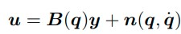
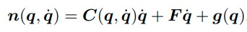
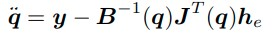
Impedance Control
Dynamic model:
with
In the presence of end effector-forces
y can be chosen as

Slide 9
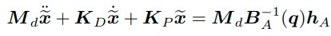
Impedance Control
Second order differential kinematics
It establishes a relationship through a generalized mechanical impedance between the vector of forces
and the vector of displacements in the operational space
The system is coupled, contact force measure to resolve this problem

Slide 10
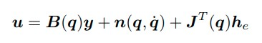
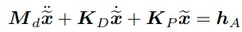
Impedance Control
Choose
with
under the assumption of error-free force measurements, yields

Slide 11
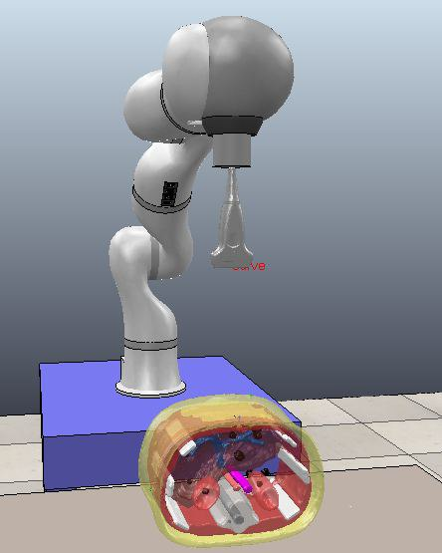
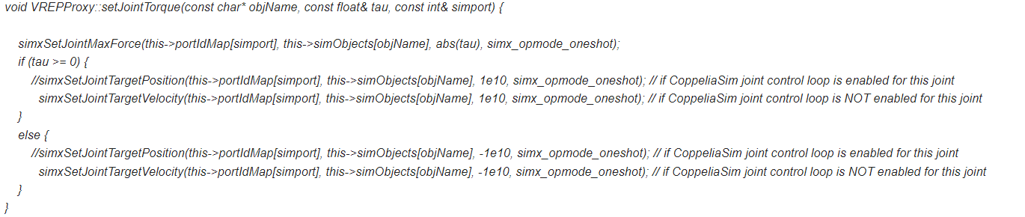
KUKA framework (1)
First attempt to resolve the task
Developed using Visual Studio and V-REP and then CoppeliaSim
V-REP scenario
In order to implement the control law, we needed the torque control while in the given framework there was the position control
→ implementation of setJointTorque()
Actually in the function setJointTorque, a function called
simxSetJointMaxForce was used but it was not compatible with V-REP version
→ change from V-REP to CoppeliaSim

Slide 12
KUKA framework (2)
CoppeliaSim scenario
Implementation of the control law
→ not working
Reduce the task to a regulation problem by using a dummy in the CoppeliaSim scene
→ randomic movement
Analyse the evolution over time of commanded and desired torques by means of plots
→ two completely different behaviours
Implementation of the easiest control law: u = g
→ failure
WE SUPPOSE A PROBLEM WITH
THE ALREADY IMPLEMENTED DYNAMIC

Slide 13
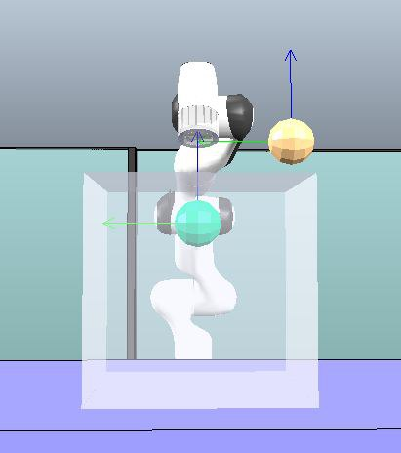
FRANKA framework (1)
Second attempt to resolve the task
Developed using Visual Studio and CoppeliaSim
This time the scene in CoppeliaSim contains only the manipulator without the phantom, the end-effector/probe and the force sensor.
Implementation of the easiest case of torque control u = g
→ all works
→ step by step increase the complexity of the control law
Implementation of the regulation task using a dummy object
→ success
Addition of the force sensor and a table with a small cube on it
→ simulation of a contact force
Implementation of the regulation control law moving the dummy just below the cube surface
→ random movement (also using block gain K) in
sensor/sensorless case

Slide 14
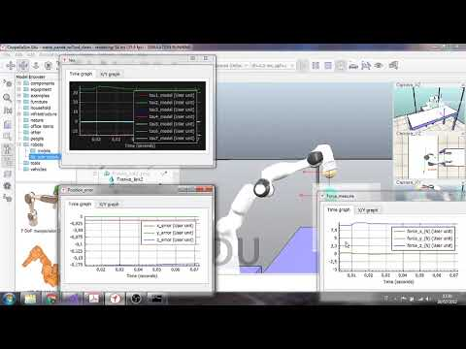
FRANKA framework (2)
In our opinion there could be several problems related to the CoppeliaSim scene or to the robot’s dynamic model and moreover we noticed that in the received scene not all the links of the robot were dynamically enabled and respondable, introducing other possible errors.

Slide 15
FRANKA Framework with ROS

Slide 16
Main requirements
ROS (melodic or noetic)
CoppeliaSim
visp_ros package
Catkin tools

Slide 17

ViSP library
It allows to control a real Panda robot
from Franka Emika.
visp_ros is an extension of ViSP library developed by Inria Rainbow team.
In visp_ros we benefit from ROS features.
Using visp_ros makes possible to simulate a Franka robot in position, velocity and force control.
All the rendering and sensing is done through CoppeliaSim while the geometric and dynamic model is handled in visp_ros.

Slide 18
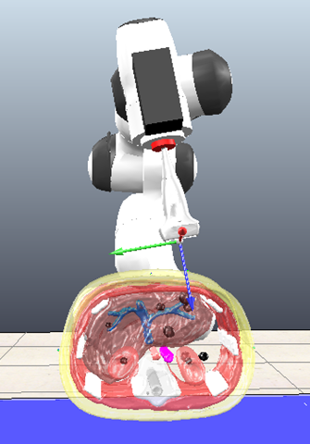
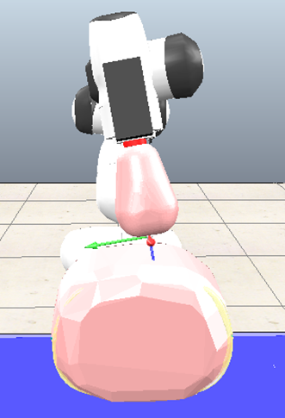
CoppeliaSim scene
A script is associated to the FRANKA
object in the scene, in which we initialize
the handlers to manage different robot
components, publishers and subscribers.
Communication between visp_ros and
CoppeliaSim is done using ROS.
Some relevant topics:
/coppeliasim/franka/joint_state: measured positions, velocities and torques
/coppeliasim/franka/g0: gravity value
/coppeliasim/franka/flMe: position xyz, orientation xyzw
/coppeliasim/franka/tool/inertia: mass, center of mass, tool position xyz, inertia values
/fakeFCI/joint_state: commanded torques.

Slide 19
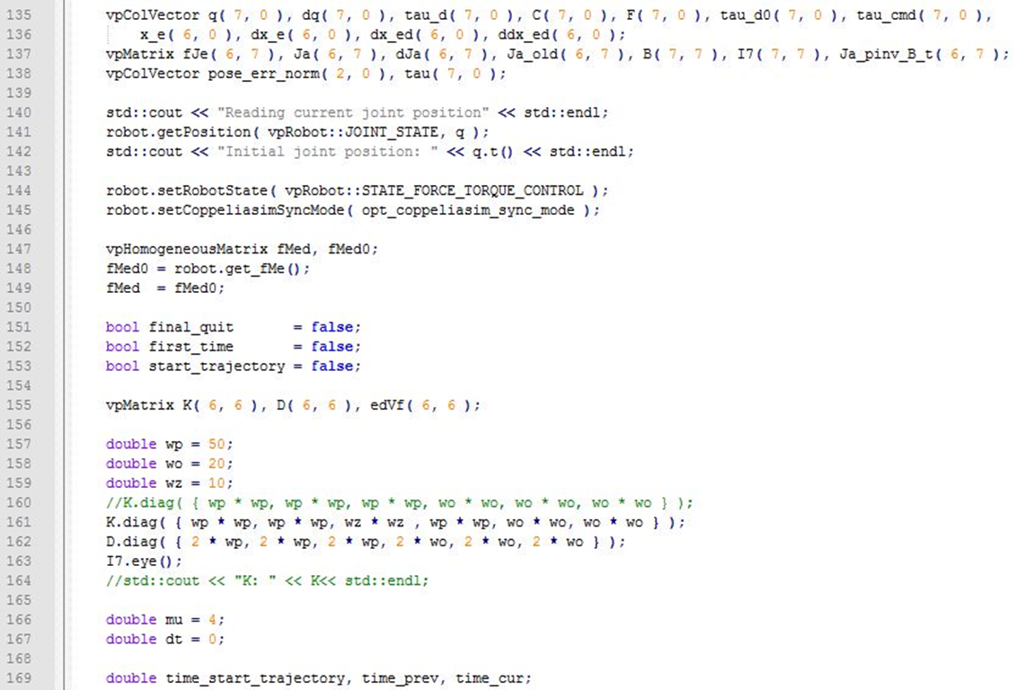
Code (0)

Slide 20
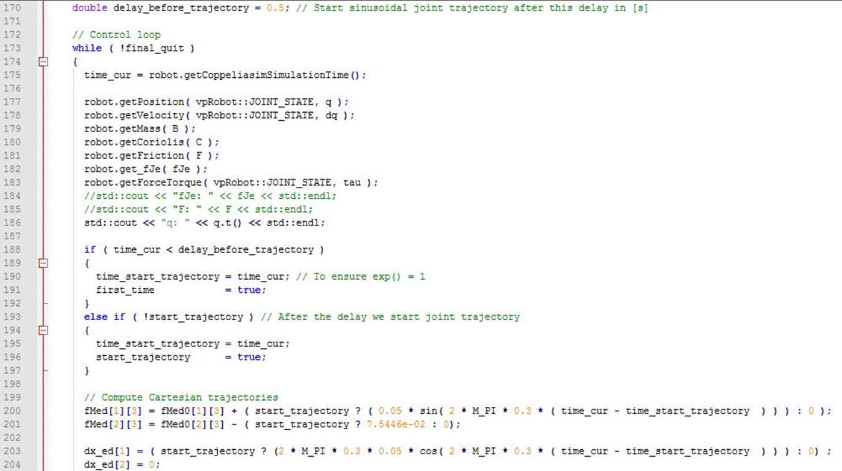
Code (1)

Slide 21
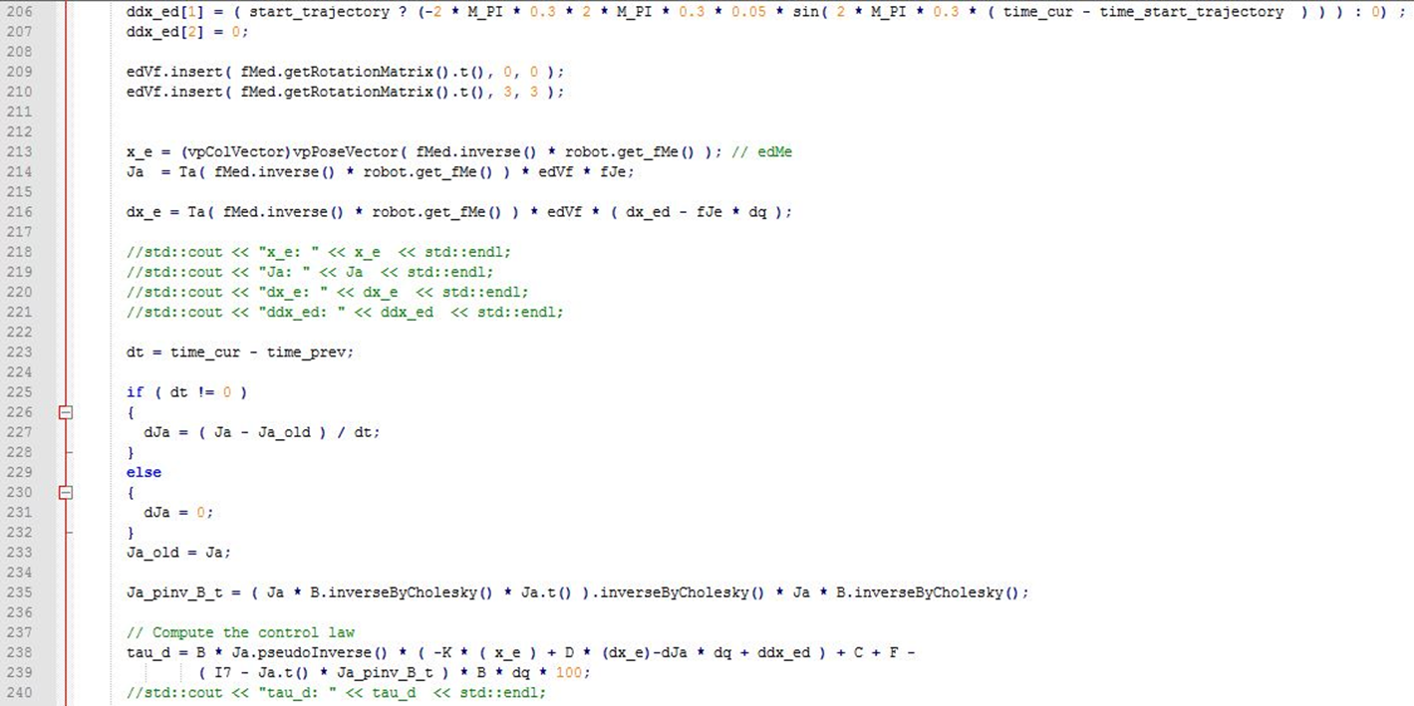
Code (2)

Slide 22
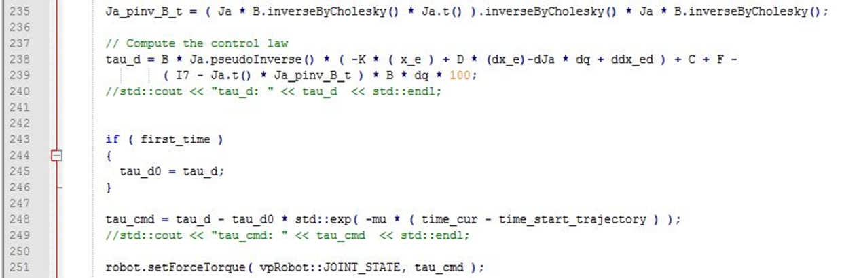
Code (3)

Slide 23
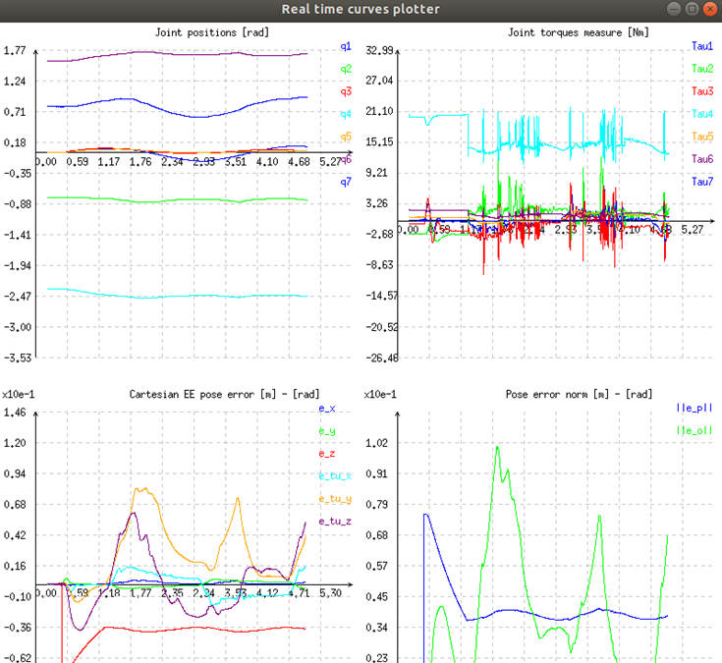
Results & Conclusions

Slide 24
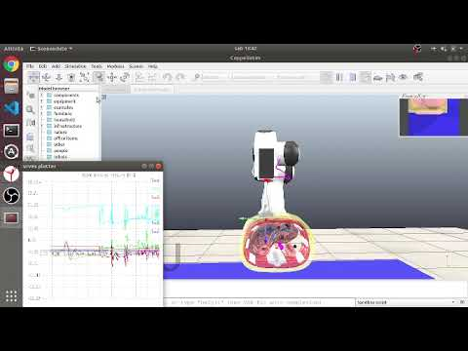

Slide 25
